Slide 1
Tere hommikust
This show is for the memory of
Jakob Hameiry (Yanci Maisel) born in Viliandi, 01/07/1913, died in Haifa in 19/11/1988.
Dov Hameiry (Bernard/Bebu Maisel) born in Viliandi, 10/01/1917, died in Kfar-Blum in 12/08/1991.
And for the memory of Maisel family members who were murdered in Tallinn, the parents Meir & Rosa Maisel, a brother and sisters:
Abram, Hanci, Zelda, Rachil, Haja.
Lately lived in 36, Jakobsoni st. Tallin.

Slide 2
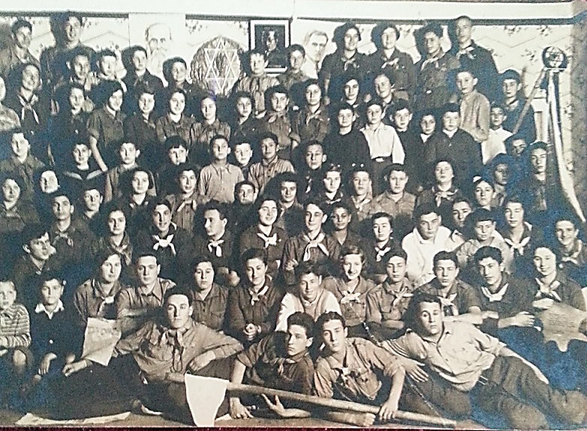
Youth movement
Tallinn 15/10/1933

Slide 3
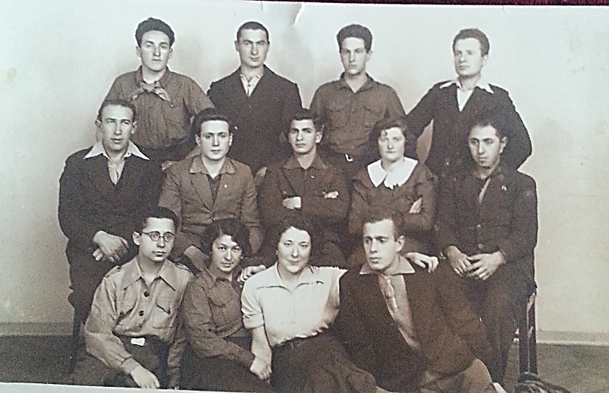
Kibbutz training in Tallinn
11/11/1933

Slide 4
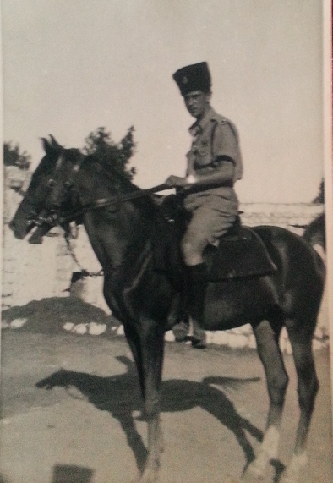
Yanci as a guard

Slide 5
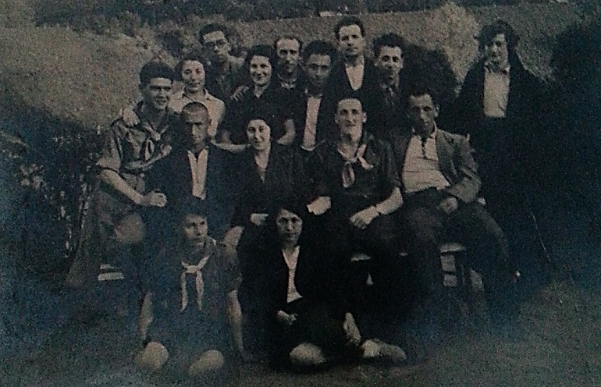
Kibbutz training
Tallinn 10/05/1934
“See you in the Kibbutz in our country"

Slide 6
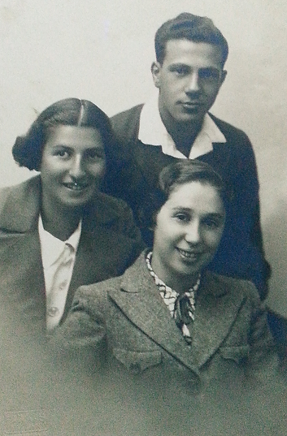
Young and shy – Dov with 2 girls

Slide 7


Slide 8
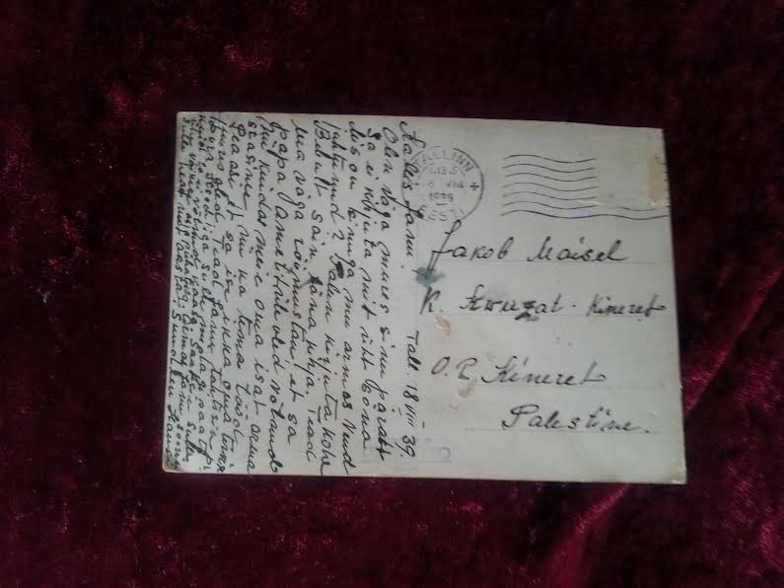

Slide 9

Same place - 60 years later

Slide 10
Yanci & Bebu
1943

Slide 11
Suur aitäh kuulata

