Slide 1
Jewish student fraternities at the University of Tartu: a part of Baltic student tradition
Toomas Hiio
Estonian Institute of Historical Memory
University of Tartu

Slide 2
University of Tartu
1632–1710 Academia Gustaviana
1802–1893 Universität Dorpat
1893–1918 Юрьевский Университет
1632: established by the King of Sweden Gustav II Adolf
1710: closed, when Russia conquered Livonian and Estonian provinces
1802: re-established by the Emperor of Russia, Alexander I as an University for the Baltic provinces with German language of instruction
1889–1892: the Russification
1918, September-November: a so-called Landesuniversität Dorpat during German occupation
1 December 1919: opened as Estonian University of Tartu

Slide 3
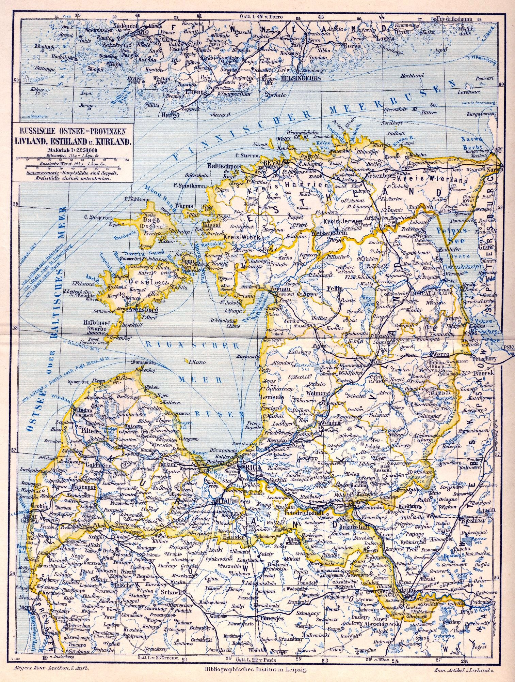
Baltic Provinces of the Russian Empire
Livonia, Estonia, Courland

Slide 4
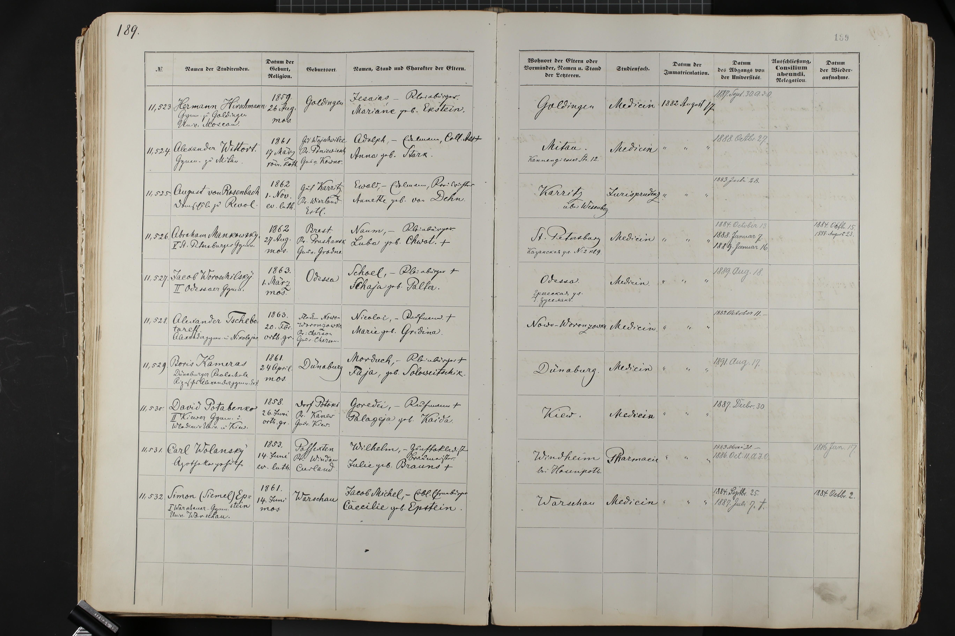
Page of the student register of the University of Tartu (from August 1882)

Slide 6
Fraternities (corporations), registered by the Minister of Enlightement according to the Rules for Corporations of 1855
Chargiertenconvent (1832/1834)
Responsible for Allgemeiner Comment
Curonia (1808, Baltic-German)
Estonia (1821, Baltic-German)
Livonia (1822, Baltic-German)
Fraternitas Rigensis (1823, Baltic-German)
Neobaltia (1879, Baltic-German)
Fraternitas Academica (1881, Germans from Russia)
Lettonia (1882, Latvian)

Slide 7
Societies, registered by the rector of the university
(„guaranteed“ (recognised) the allgemeiner Comment)
Theologischer Verein (1867)
Estonian Students Society (1870/1884, Estonians)
Academic Jewish Society of History and Literature (1872/1883)
Russian Students Society (1879/1881/1885)
Literature and Music Society (1883–1907, merged to Limuwia)
Scientific Association of History and Literature (1884–1907, merged to Limuwia)
Society of Friends of Science (1888–1907, then restored as Polonia, est. 1828)
Literary-Scientific Society (1888–1899, Latvians)
Polish Theology Students’ Society (1901)

Slide 8
Academic Jewish Society of History and Literature
1872: established as Academic Society for Learning Jewish History and Culture
9 (21) December 1883: registered by the Rector
25 October 1938: renamed to Academic Jewish Society of History and Literature
Closed in 1940/1941

Slide 9
Limuwia
Freundschaft, Ehre, Nation
Amore more ore re firmantur amicitiae
1907: merger of Literature and Music Society (est. 1883) and Jewish University Students’ Scientific Association of History and Literature (est. 1884) to Literature, Music and and Science Society of Jewish Students
(in German: Literärisch-Musikalischer und Wissenschaftlicher Verein)
1925: reorganised to the corporation Limuwia with anniversary
at 21 October 1883
Abolished at the turn of 1940/1941

Slide 11
Hasmonaea (Hasmonea)
1915–1918: Kadimah ???
1923: group of founders left the Academic Society for Knowledge of Jewish History and Culture
Zionist fraternity, recognised the Basel Programme
1 April 1926: public presentation with colours (anniversary of the University of Jerusalem)
Official anniversary: 12 January 1923

Slide 12
Hasmonaea
„spezieller Comment“
the internal rules of the corporation

Slide 13
Jewish Female Students Association Hazfiro (Hacfiro)
Separated from the Academic Jewish Society of History and Literature
Registered on 27 February 1925 with the Council of the University
External feature: an emblem with the first letters of the Yiddish name Verband jidischer Studentinen Hacfiro Dorpat
Closed due to lack of members in 1938
Majority of former members joined the Academic Jewish Society of History and Literature

